Slide 1
The Effects of Incarceration on Illicit Drug Use:
An Economic Approach
Connor Vaughan

Slide 2
Research Question
How does a state’s incarceration rate affect its rate of illicit drug use?

Slide 3
Literature Review
Economic factors associated with illicit drug use
Unemployment and illicit drug use- Hollingsworth, Ruhm, and Simon (2017)
How illicit drug use affects the economy
Employment and labor force participation- French, Roebuck, and Alexandre (2001)
Recent efforts to reduce illicit drug use
Drug courts- Sevigny, Pollack, and Reuter (2013)
Substance abuse programs in prisons- Zarkin (2012)

Slide 4
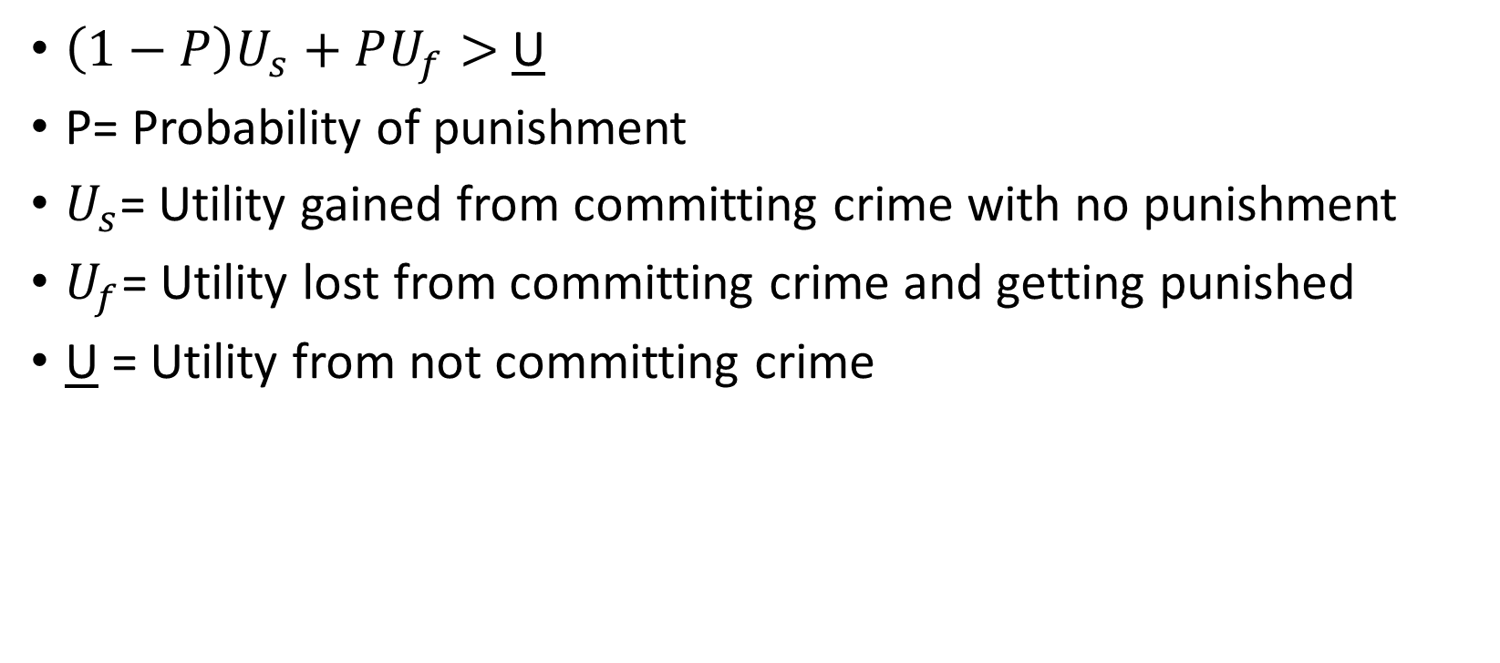
Economic Model
$\left(1−P\right)U_{s}+PU_{f}>$ U
P= Probability of punishment
$U_{s}$= Utility gained from committing crime with no punishment
$U_{f}$= Utility lost from committing crime and getting punished
U = Utility from not committing crime

Slide 5





An Individual’s Utility
Marginal
Total
Utility
Utility
$$U_{f}$$
$$U^{∗}$$
$$U^{∗}$$
U
s
$$D^{∗}$$
$$D^{∗}$$
Frequency of
Frequency of
Illicit Drug Use
Illicit Drug Use

Slide 6
Methodology
 | Mean | Standard Deviation
Illicit Drug Use Per Capita | .106 | .029
Incarceration Per Capita | .0058 | .0019
Unemployment Rate | 4.6% | .99
% H.S. Graduate | 87.11% | 3.34
GDP Per Capita | 47,686.22 | 9,105.79

Slide 7
Scatter Plot of Primary Variables

Slide 8
Regression Results
 | Regression 1 2016 | Regression 2 % △ 2015 | Regression 3 % △ 2014 | Regression 4 % △ 2013 | Regression 5 % △ 1985 | Regression 6 Corrections Pop.
Incarceration Per Capita | -7.83*** (2.65) | -.29** (.122) | -.18** (.074) | -.20*** (.059) | -.64 (.64) | -.251 (.604)
Unemployment Rate | .0095* (.0048) | .00096 (.0055) | .0041 (.005) | .0021 (.0048) | -.0069 (.0052) | .007 (.005)
% High School Graduate | .0017 (.0016) | .0025 (.0016) | .0029* (.0016) | .0032** (.0015) | .0035** (.0017) | .003*** (.001)
GDP per Capita (in thousands) | -0.0003 (0.0005) | -.0003 (.0005) | -.0003 (.0005) | -.0003 (.0004) | -0.00004 (.0005) | .0001 (.005)
Adjusted R Squared | .18 | .13 | .14 | .23 | .05 | .028
***, **, * represent statistical significance at the 99%, 95%, and 90% respectively.

Slide 9
Conclusions
Limitations
Data alternatives
Policy Implications
Other factors to consider
Future Research
Where can economic analysis be applied more effectively?

Slide 10
Works Cited
Corman, Hope, Dhaval M. Dave, Dhiman Das, and Nancy E. Reichman. 2013. “Effects of Welfare Reform on Illicit Drug Use of Adult Women.” Economic Inquiry 51 (1): 653 -74
doi:http://onlinelibrary.wiley.com.proxy.lib.csus.edu/journal/10.1111/%28ISSN%291465-7295/issues.
French, Michael T., M. Christopher Roebuck, and Pierre Kebreau Alexandre. 2001. “Illicit Drug Use,Employment, and Labor Force Participation.” Southern Economic Journal 68 (2): 349–68.
doi:http://onlinelibrary.wiley.com.proxy.lib.csus.edu/journal/10.1002/(ISSN)2325-8012.
Becker, Gary S. 2014. “Crime and Punishment: An Economic Approach.” In Economic Models of Law, edited by Thomas J. Miceli and Matthew J. Baker, 423-71. Elgar Research
Collection. Economic Approaches to Law, vol. 44 Cheltenham, UK and Northampton, MA: Elgar. http://proxy.lib.csus.edu/login?url=http://search.ebscohost.com/login.aspx?direct=true&db=ecn&AN=1658207
Hollingsworth, Alex, Christopher J. Ruhm, and Kosali Simon. 2017. “Macroeconomic Conditions and Opioid Abuse.” Journal of Health Economics 56 (December): 222–33.
http://proxy.lib.csus.edu/login?url=http://search.ebscohost.com/login.aspx?direct=true&db=ecn&AN=1690598.
Mumola CJ, Karberg JC. 2006. Drug use and dependence, state and federal prisoners, 2004.
Bureau of Justice Statistics Special Report, NCJ 213530, Revised 19 January 2007, U.S. Department of Justice, Office of Justice Programs, Washington, DC.

Slide 11
Works Cited Cont.
Sevigny, Eric L., Harold A. Pollack, and Peter Reuter. 2013. “Can Drug Courts Help to Reduce Prison and Jail Populations?” Annals of the American Academy of Political and Social
Science 647 (May): 190–212.
doi:http://ann.sagepub.com.proxy.lib.csus.edu/content/by/year.
Substance Abuse and Mental Health Services Administration. “State Reports From the 2016 NSDUH.”
https://www.samhsa.gov/data/nsduh/state-reports-NSDUH-2016.
U.S. Department of Education, Office of Elementary and Secondary Education, Consolidated State
Performance Report, 2015–16. “Public High School Graduation Rates, 2016.”
https://nces.ed.gov/programs/coe/pdf/coe_coi.pdf
Zarkin, Gary A. 2012. “Benefits and Costs of Substance Abuse Treatment Programs for State Prison Inmates: Results from a Lifetime Simulation Model.” Health Economics 21 (6): 633–52.
doi:http://onlinelibrary.wiley.com.proxy.lib.csus.edu/journal/10.1002/%28ISSN%291099-1050/issues.

